Slide 1

Special Session: Technology in the Service of Classical and Historical Languages
By Esteban Belmehdi, Ioanna Papadopoulou, Julien Razanajao (ARCAS Team, CHS Harvard University), and joint work with AthDGC, NKUA (60 min)
AthDGC Team Members: Nikolaos Lavidas, Theodoros Michalareas, Vassilios Symeonidis, Sofia Chionidi, Anastasia Tsiropina, Eleni Plakoutsi
A collaborative presentation on the intersection of digital technology and historical linguistics.

Slide 2


The Research Partnership
A strategic alliance to study language change across continents.
Uniting computational methods with deep philological expertise.

Slide 3
Project Vision
Digital Infrastructure: Creating a robust platform for historical linguistic data.
Data Sharing: A unified ecosystem for sharing digital humanities resources.
Focus: Comprehensive diachronic study of Greek and other Indo-European languages.

Slide 4

Theoretical Foundation: Valency
Lucien Tesnière (1959)
Valency is the capacity of a verb to bond with a specific number of arguments.
Core Question
It dictates the structure and components of the clause.

Slide 5
Valency Change Markers
Valency shift is observed through three main linguistic phenomena:
Transitivity Alternations: Shifts between transitive (two arguments) and intransitive (one argument) uses.
Voice Morphology: The rise, decay, or reanalysis of Active, Middle, and Passive systems.
Case Systems: The loss or development of morphological case marking.

Slide 6
Focus: Lability (Zero Derivation)
Definition
Example (English)
Verbs that function as both transitive and intransitive without any formal morphological change (Lavidas, 2009).
Transitive: "I break the glass."
Intransitive: "The glass breaks."

Slide 7



Mechanism: Voice Systems
Many Indo-European languages historically used Voice morphology to signal valency changes.
The Middle Voice traditionally functioned as an anticausative marker.

Slide 8
Mechanism: Causative Strategies
Strategies used to mark causative/anticausative pairs in diachrony:
Morphological: Affixation or inflection (e.g., Old English).
Syntactic: Auxiliary verbs or periphrasis.
Suppletion: Using entirely different roots for transitive and intransitive (e.g., "kill" vs. "die").

Slide 9

Typological Scale of Spontaneity
Haspelmath (1993) notes that valency marking correlates with the inherent nature of the event.
High Spontaneity:
Low Spontaneity:

Slide 10
Greek Case Study: Ancient System
Voice Dominant: Ancient Greek relied heavily on morphological distinctions.
Tripartite System: Distinct Active, Middle, and Passive forms.
Low Lability: Lability was rare and mainly confined to inanimate subjects.

Slide 11
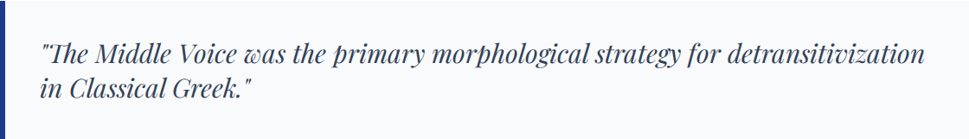
The Middle Voice Function
It covered reflexive actions, spontaneous events, and movements.

Slide 12


The Post-Classical Shift: Morphological Collapse
Over centuries, the distinct Middle Voice morphology began to collapse, merging with Passive constructions.
This morphological decay necessitated a new syntactic solution for transitivity alternation.

Slide 13
Modern Greek: Rise of Lability
New Strategy: As voice distinctions faded, Modern Greek adopted Lability.
Typological Change: The shift from a Voice-based system to a Lability-based system constitutes a fundamental typological restructuring.

Slide 14


Greek Diachronic Summary
Ancient
Modern

Slide 15
Comparative: English Case Study
English, while genetically related, followed a parallel evolutionary path accelerated by different factors.
Old English: Had a richer case and voice system, closer to the Ancient Greek type.
Causative Markers: Used affixes (e.g., -jan) to derive transitive forms.

Slide 16
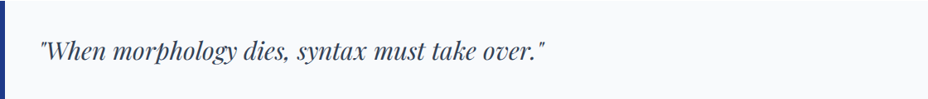
English: The Loss of Inflections
The transition to Middle English involved a dramatic loss of inflectional endings (Visser, 1963).
This necessitated the adoption of fixed Subject-Verb-Object (SVO) order and a sharp increase in lability.

Slide 17
Modern English: High Lability
English represents the maximal end of the lability spectrum in Indo-European.
Zero-Derivation: Nouns frequently become verbs, and intransitives become transitives with no morphological change.
Widespread Use: High frequency of labile verbs across all registers.

Slide 18
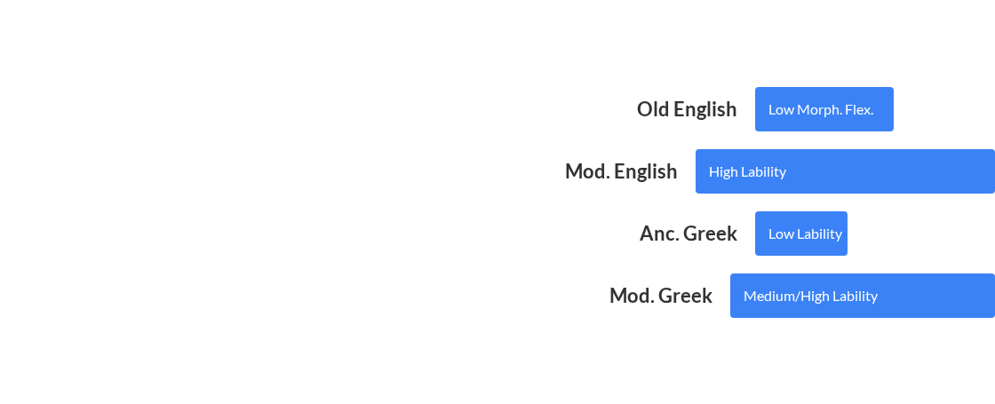
Comparative Analysis: Valency Trends
Parallel Shift
Both Greek and English moved from rich Morphological encoding to reliance on Syntactic and Lexical strategies.

Slide 19

Indo-European Comparative: Vedic Sanskrit
The drift toward lability is not universal across IE subfamilies.
Vedic Sanskrit: Showed a decline in lability over time (Kulikov, 2014).
Contrast: Unlike Greek/English, Indo-Iranian languages often maintained or reinforced morphological complexity in valency marking.

Slide 20
Indo-European Comparative: Summary
The project seeks to map these divergent paths:
Analytic Drift: Greek and Germanic branches moving toward analytic (syntactic) encoding.
Conservative Branches: Languages like Sanskrit maintaining synthetic (morphological) complexity.
Goal: Provide empirical data to test typological theories on complexity and language decay.

Slide 21
Role of Language Contact: Retranslations
Retranslations as Controlled Evidence
Translators mediate between the source language structures and the evolving norms of the target language.

Slide 22


Methodology: Corpus Linguistics
Collaboration with CHS Harvard University provides the computational platform for corpus processing.
Parallel Alignment: Mapping corresponding sentences for precise cross-temporal comparison.
Infrastructure: Servers hosted by Harvard University, CHS ensure high-performance processing.

Slide 23
The AthDGC Query System
A specialized digital tool for investigating language change, developed with ARCAS infrastructure.
Function: Allows complex queries targeting specific morphological-to-syntactic shifts.
Output: Statistical frequency charts across specified time periods for validation.

Slide 24
Expected Outcomes
Empirical Data: Large-scale, validated data on Greek and English valency shifts.
Theoretical: New models for Grammaticalization and Cyclic language change.
Research Resource: A searchable, contrastive database for the wider academic community.

Slide 25
Selected Bibliography
Haspelmath, M. (1993). More on the typology of inchoative/causative verb alternations. In B. Comrie & M. Polinsky (Eds.), Cause and Control: The Typology of Voice. MIT Press.
Kulikov, L. (2014). Typology of Labile Verbs: Focus on Diachrony. Linguistics 52(4).
Lavidas, N. (2009). Transitivity Alternations in Diachrony: Changes in Argument Structure and Voice Morphology. Cambridge Scholars Publishing.
Tesnière, L. (1959). Éléments de syntaxe structurale. Klincksieck.
Visser, F. T. (1963). An Historical Syntax of the English Language. Brill.

Slide 26



Image Sources
https://static.vecteezy.com/system/resources/previews/070/998/760/large_2x/abstract-data-visualization-with-flowing-lines-and-graph-elements-on-a-light-background-photo.jpg
Source: www.vecteezy.com
https://img.freepik.com/premium-photo/colorful-geometric-fluid-shapes-abstract-background-design-ar-169-job-id-eade4e3598aa4983a5497d002ca_524325-5830.jpg
Source: www.freepik.com
https://static.vecteezy.com/system/resources/thumbnails/024/222/251/small/abstract-technology-smart-city-online-network-concept-vector.jpg
Source: www.vecteezy.com

